Slide 1

Mini-Project CS3PC04
To:
Prof. Jyotsana Goyal
By:
Aditya Raj Singh Tomar EN22CS301062
Akash Ghosh EN22CS301082
Akash Ravi Jaisinghani EN22CS301084
Of Batch B1

Slide 2

Implementation of Smart Vitality Tracker with AI

Slide 3
Technologies
Pandas : Pandas is used for handling data in .csv format as DataFrames.
NumPy : NumPy provides an array object of arbitrary homogeneous items, fast mathematical operations over arrays.
SkLearn : SkLearn is a Python module integrating classical machine learning algorithms in the tightly-knit world of scientific Python packages (numpy, scipy, matplotlib).
Metrics(mean_squared_error), Model selection(train_test_split), Pipeline(Pipeline, make_pipeline), Impute(SimpleImputer), Preprocessing (StandardScaler), Linear Model (LinearRegression).
Seaborn/MatPlotLib : Seaborn/MatPlotLib are libraries used for plotting of data.
PyQt5 : A package developed for easy UI designing and event handling connections (signals/slots).
SciPy : Fundamental algorithms for optimization, Extends NumPy, Provides Specialized data structures.
JobLib : Joblib enables multiprocessing across several machines or cores on a single machine, which enables programmers to parallelize jobs across numerous machines. Saves and Loads ML Models.

Slide 4
Dataset Sample (Sleep Efficiency)
1 | ID | Age | Gender | Bedtime | Wakeup time | Sleep duration | Sleep efficiency | REM sleep percentage | Deep sleep percentage | Light sleep percentage | Awakenings | Caffeine consumption | Alcohol consumption | Smoking status | Exercise frequency
2 | 1 | 65 | Female | 2021-03-06 01:00:00 | 2021-03-06 07:00:00 | 6.0 | 0.88 | 18 | 70 | 10 | 0.0 | 0.0 | 0.0 | Yes | 3.0
3 | 2 | 69 | Male | 2021-12-05 02:00:00 | 2021-12-05 09:00:00 | 7.0 | 0.66 | 24 | 28 | 53 | 3.0 | 0.0 | 3.0 | Yes | 3.0
4 | 3 | 40 | Female | 2021-05-25 21:30:00 | 2021-05-25 05:30:00 | 8.0 | 0.89 | 20 | 70 | 10 | 1.0 | 0.0 | 0.0 | No | 3.0
5 | 4 | 40 | Female | 2021-11-03 02:30:00 | 2021-11-03 08:30:00 | 6.0 | 0.51 | 28 | 25 | 52 | 3.0 | 50.0 | 5.0 | Yes | 1.0
6 | 5 | 57 | Male | 2021-03-13 01:00:00 | 2021-03-13 09:00:00 | 8.0 | 0.76 | 27 | 55 | 18 | 3.0 | 0.0 | 3.0 | No | 3.0
7 | 6 | 36 | Female | 2021-07-01 21:00:00 | 2021-07-01 04:30:00 | 7.5 | 0.9 | 28 | 60 | 17 | 0.0 | Na | 0.0 | No | 1.0

Slide 5
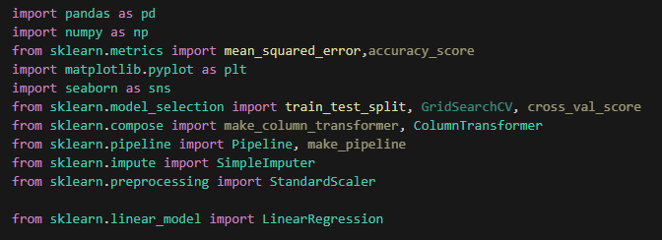
Code: Sleep Analysis Model (Overview)

Slide 6
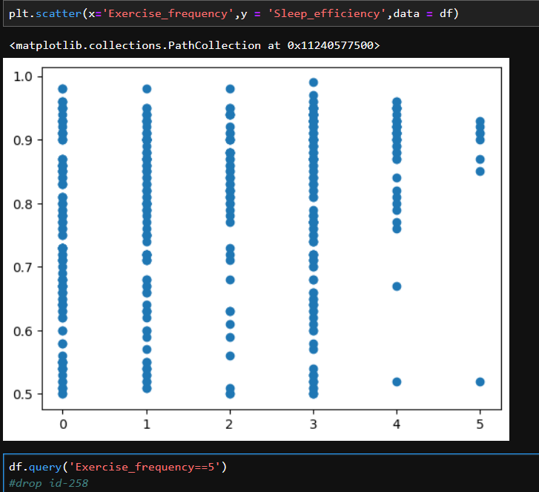
Finding Outliers: Sleep Analysis Model (Overview)
This Scatter-plot shows us the relation between “Exercise Frequency” and “Sleep Efficiency”.
The graph can be interpreted as higher the exercise frequency, higher the sleep efficiency.
The data-point that shows otherwise, needs to be dropped.

Slide 7
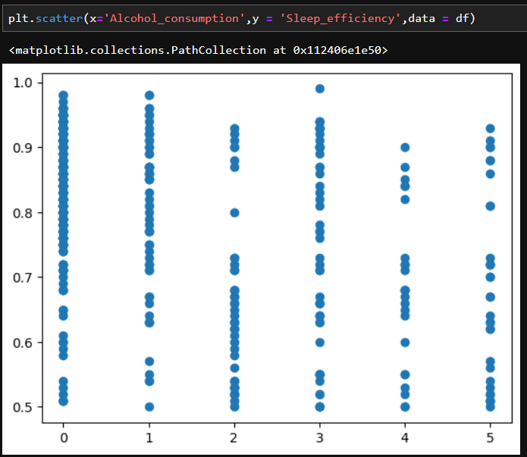
Finding Outliers: Sleep Analysis Model (Overview)
This Scatter-plot shows us the relation between “Alcohol Consumption” and “Sleep Efficiency”.

Slide 8
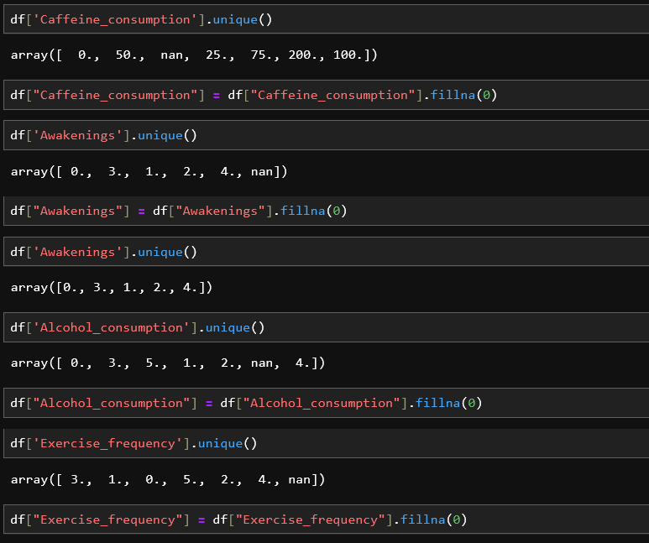
Data Cleaning: Handling the missing Values
The next step is to remove any missing Values and filling them with a default value.

Slide 9
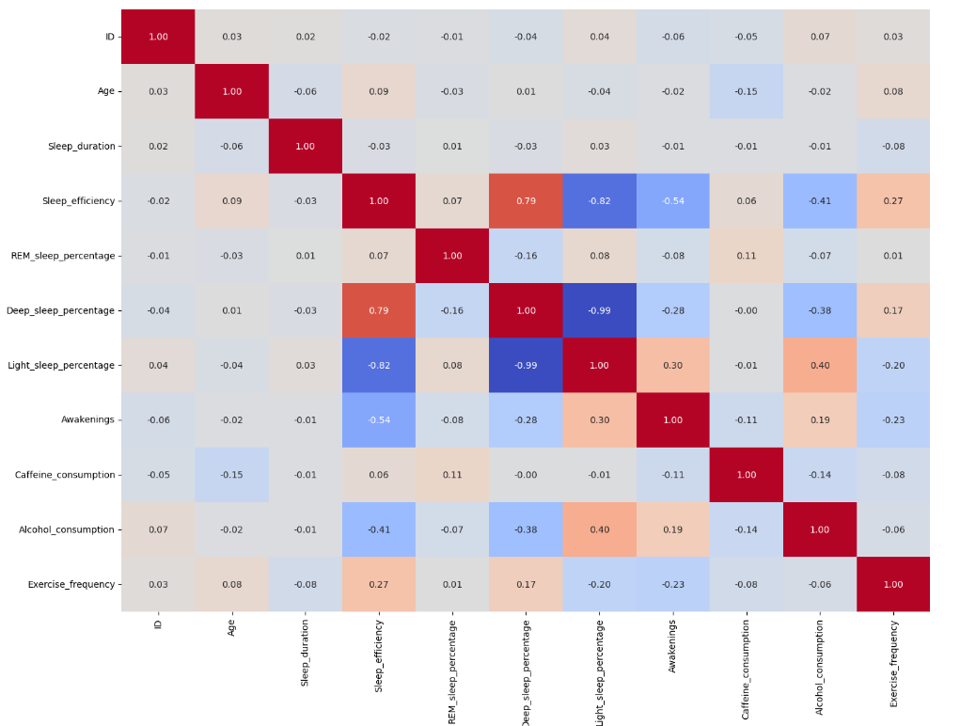
Feature Engineering: HeatMap
The HeatMap shows that the correlation coefficient between “light sleep %” and “Deep Sleep %” is 0.99, and thus one needs to be dropped.

Slide 10
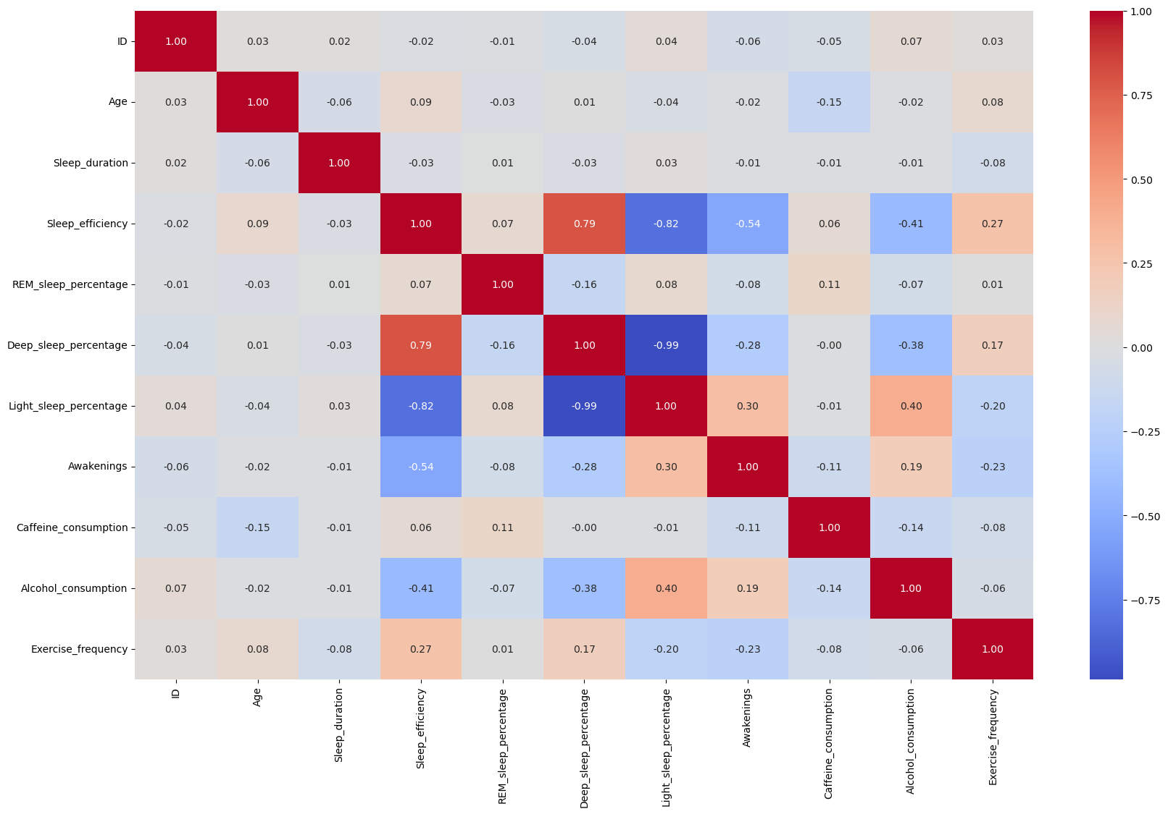
Feature Engineering: HeatMap

Slide 11
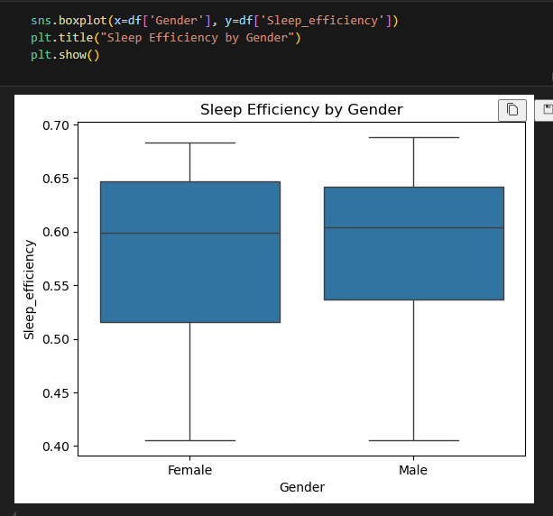
Feature Engineering: impact of gender on sleep efficiency
The box plot shows that gender does not significantly affect sleep efficiency and can therefore be dropped as a variable.

Slide 12
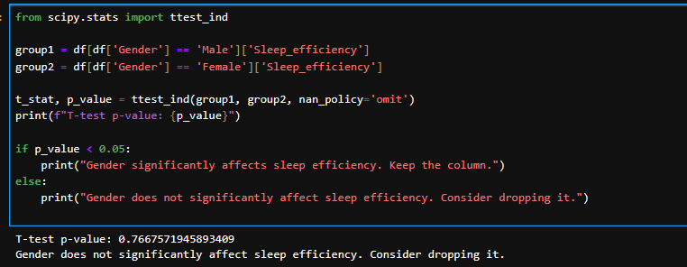
Feature Engineering: impact of gender on sleep efficiency.
This can also be verified by conducting a T- test , the p-value is high and therefore, gender doesn’t affect Sleep Efficiency.

Slide 13
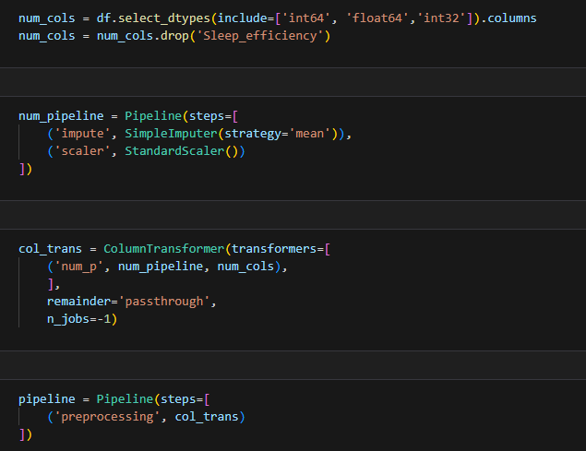
Preparing Pipeline: Sleep Analysis Model (Overview)

Slide 14
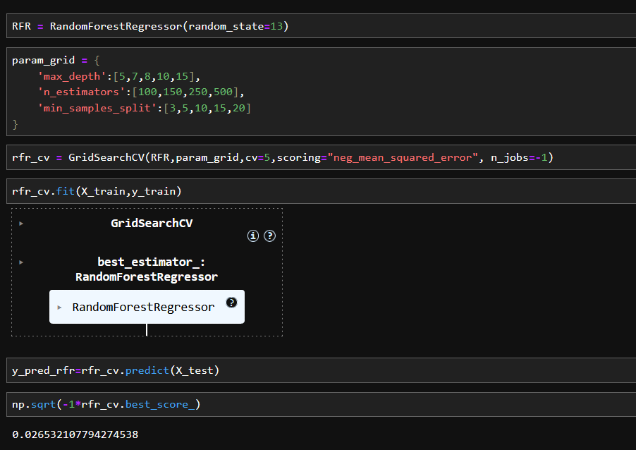
Splitting and training: Sleep Analysis Model (Overview)
Using RandomForestRegressor and GridSearchCV , the MSE value is 0.0265.

Slide 15
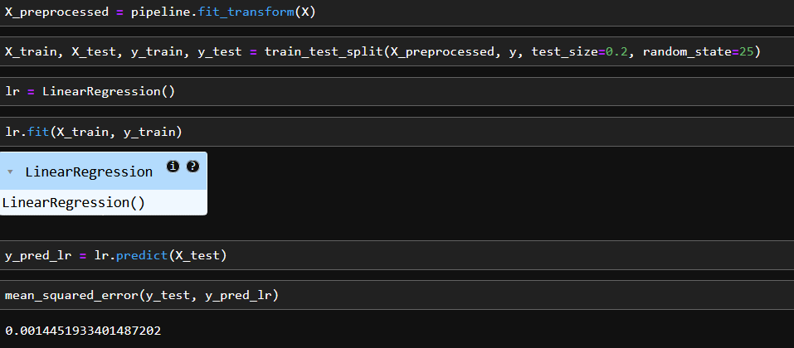
Splitting and training: Sleep Analysis Model (Overview)
Using Linear Regression Model, the lower MSE value implies that LR is a better fit for our Model.

Slide 16
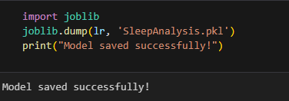
Using Joblib: Sleep Analysis Model (Overview)
Using joblib to save our Trained Sleep Analysis Model.

Slide 17

UI Design using React + Vite

Slide 18
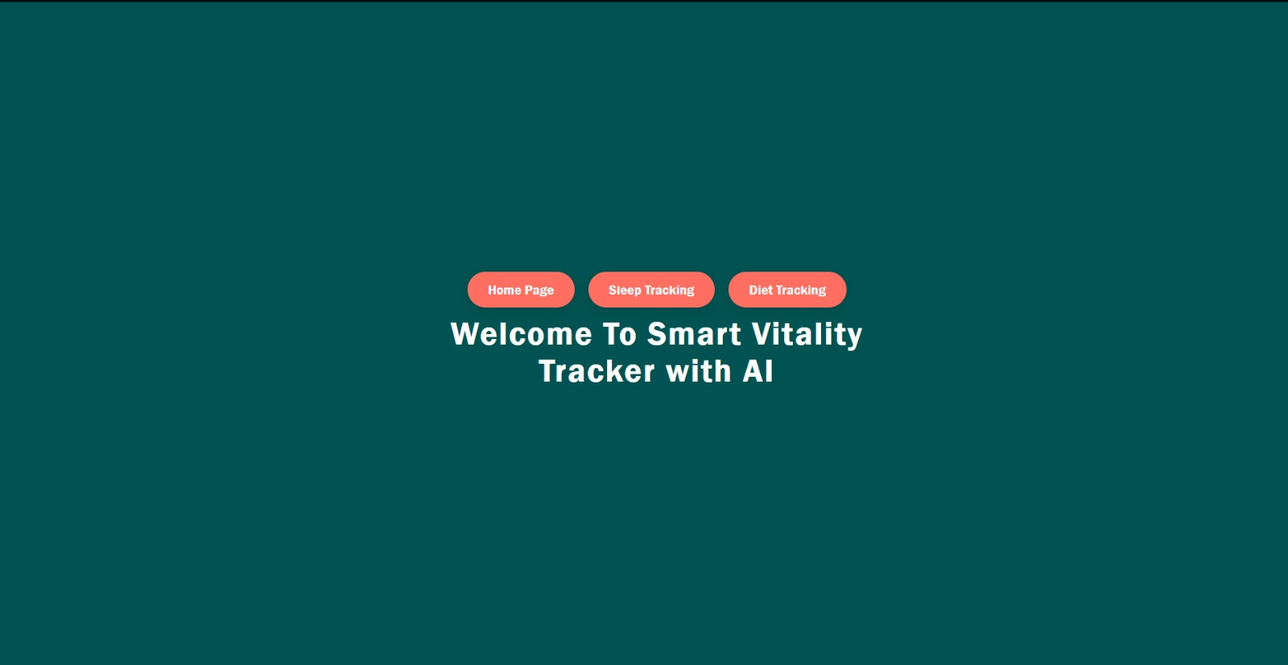
Code: UI Design by React + Vite (Overview)

Slide 19
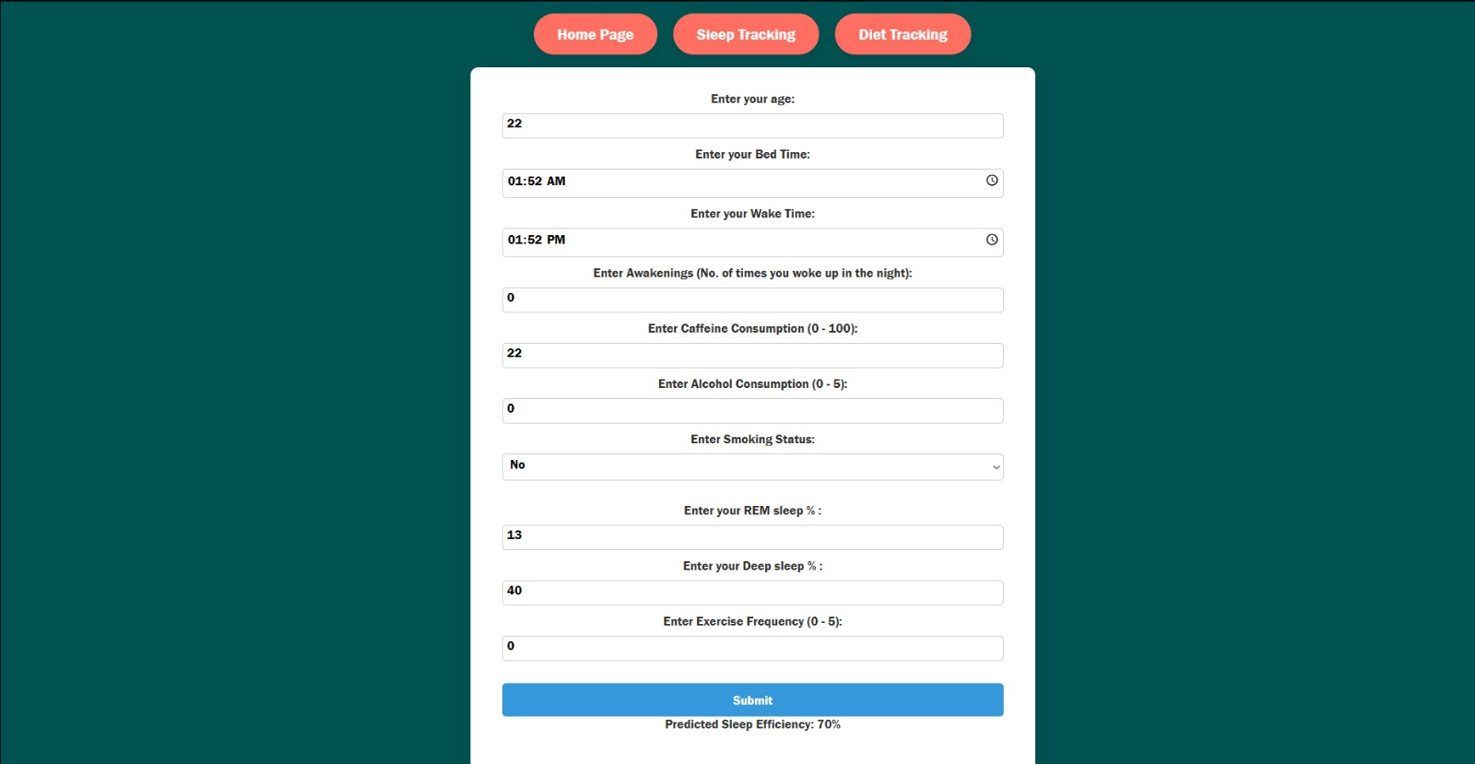
Code: UI Design by React + Vite (Overview)

Slide 20
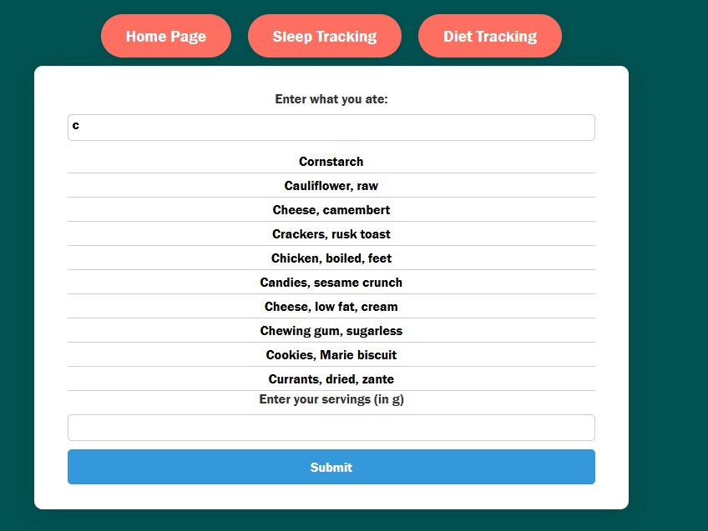
Code: UI Design by React + Vite (Overview)

Slide 21
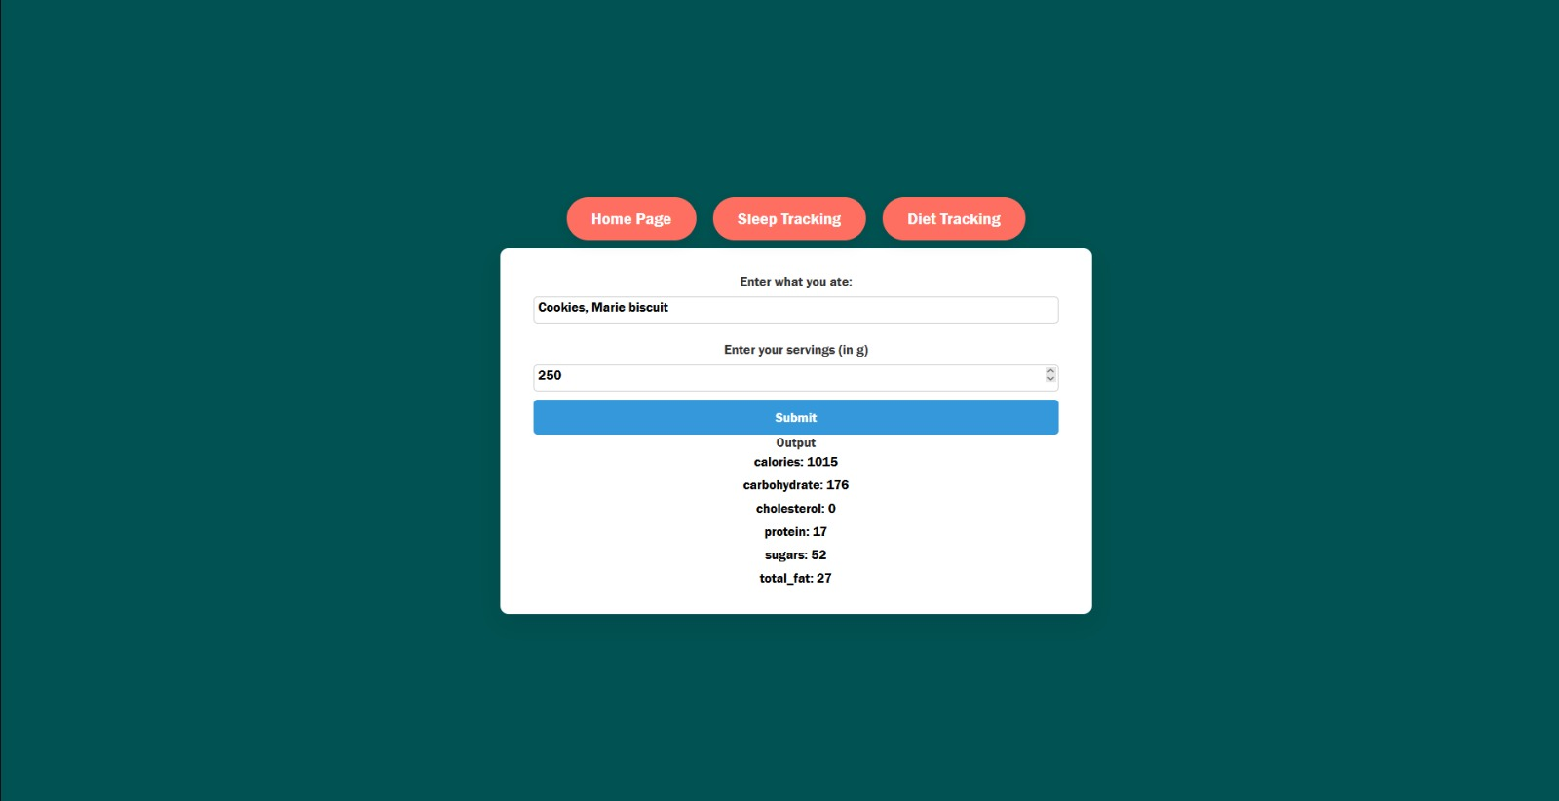
Code: UI Design by React + Vite (Overview)

Slide 22
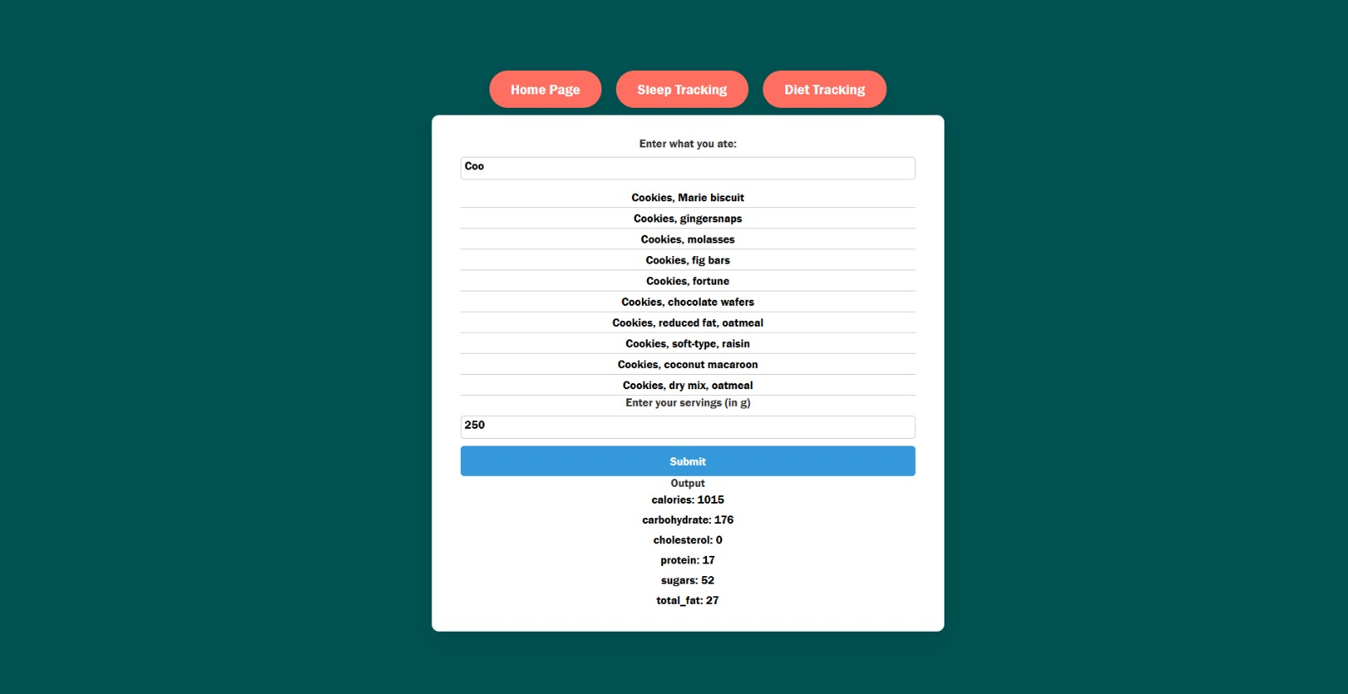
Code: UI Design by React + Vite (Overview)

